Slide 1
IHEP SUSY Group Meeting
Chengxin Liao
Institute of High Energy Physics Chinese Academy of Sciences Aug 21, 2025

Slide 2
C1N2 Status
Update VV CR/VR
Split run2 and run3 then Update Bkg estimation(Done)
Update support-note(Ongoing)

Slide 3
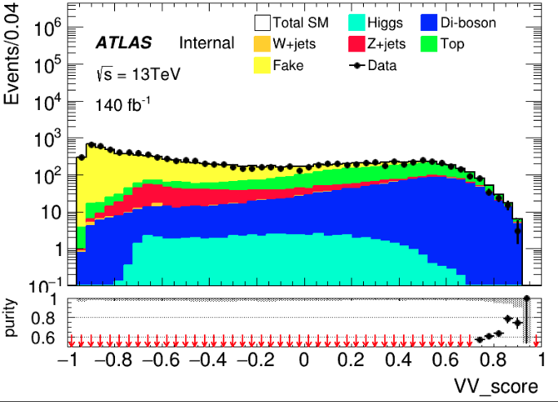
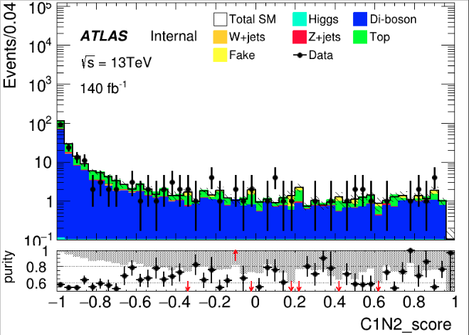
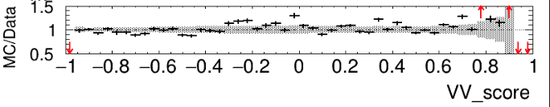
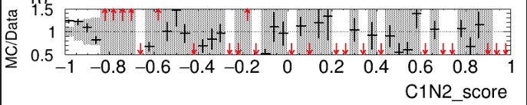
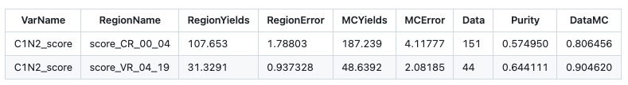
VV CR/VR run2(LH)
Pre-selection + VV score > 0.7 CR: C1N2 score < -0.6
VR: -0.6 < C1N2 score < 0.9
After apply VV score cut at 0.7
Poor estimation in high score

Slide 4
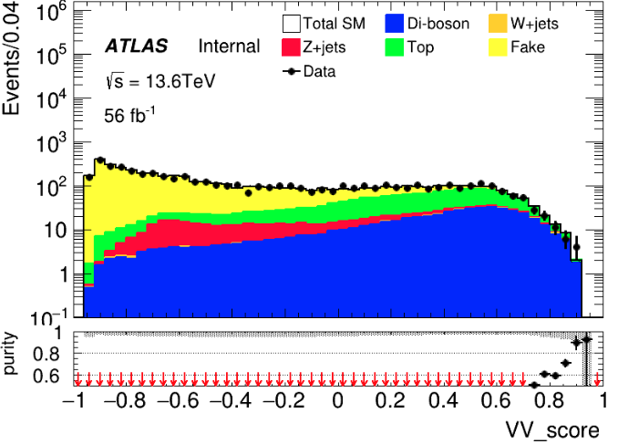
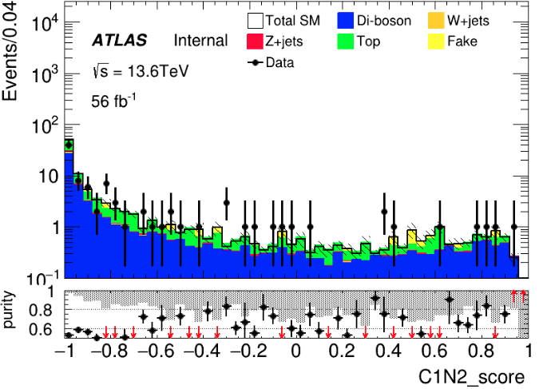
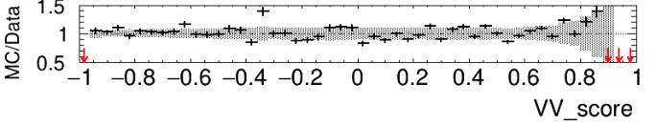
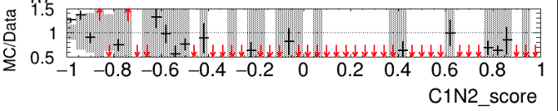
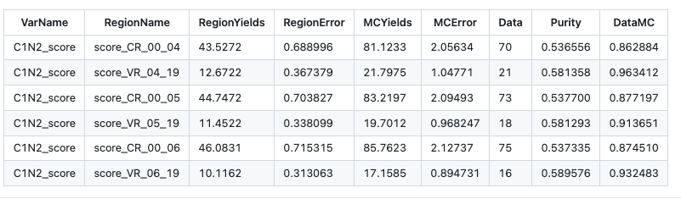
VV CR/VR run3(LH)
Pre-selection + VV score > 0.7 CR: C1N2 score < ?
VR: ? < C1N2 score < 0.9
[-1,1]->[0,20]
Poor estimation in high score
After apply VV score cut at 0.7
-0.6
-0.5
-0.4

Slide 5
Backup

Slide 6
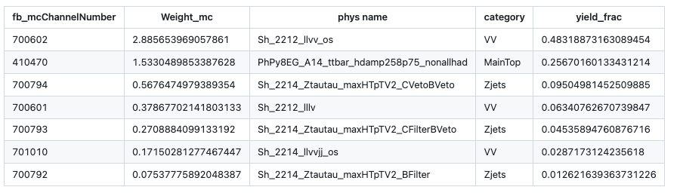
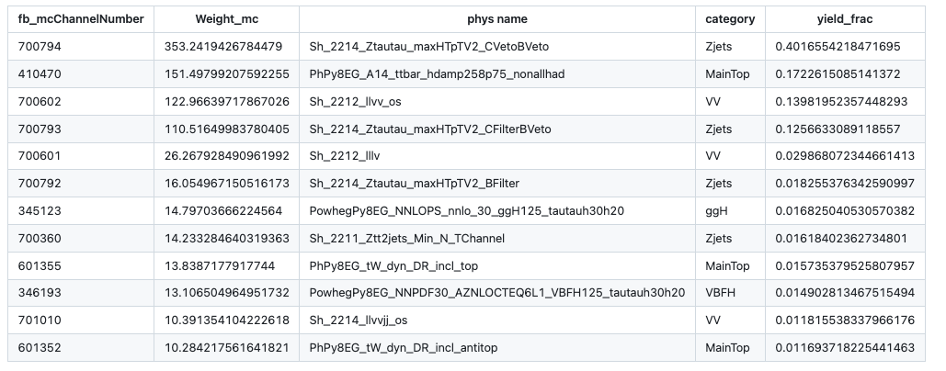
SR bkg info
HH run2 sample with cut
HH run2 sample without cut

Slide 7
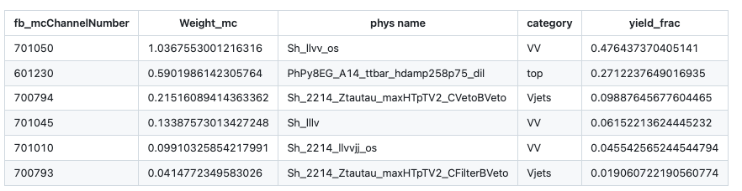
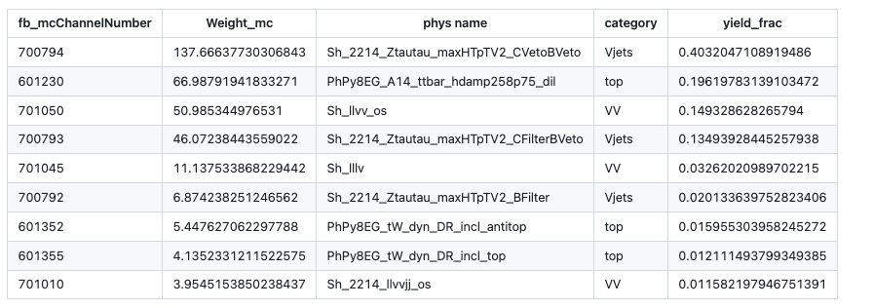
SR bkg info
HH run3 sample with cut
HH run3 sample without cut

Slide 8
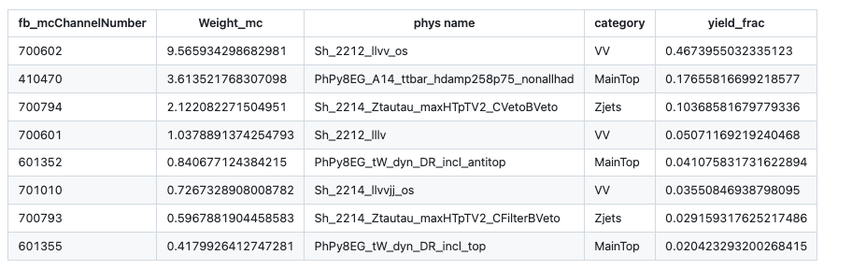
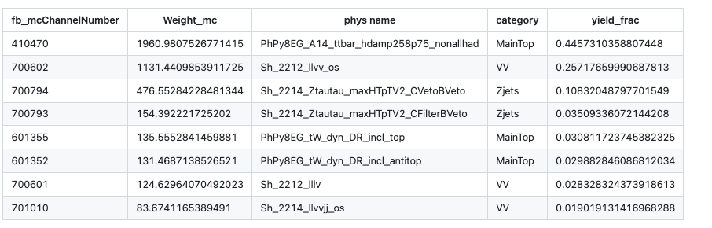
SR bkg info
LH run2 sample with cut
LH run2 sample without cut

Slide 9
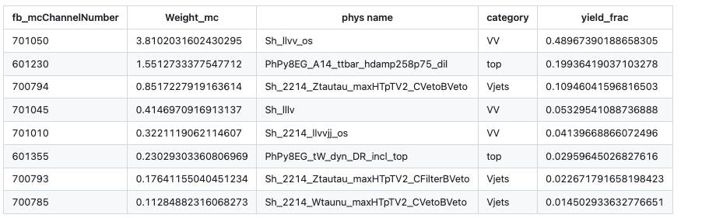
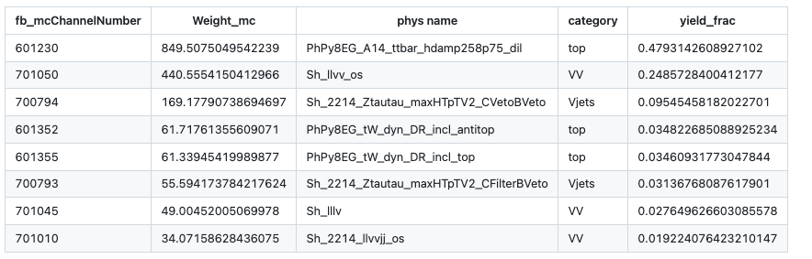
SR bkg info
LH run3 sample with cut
LH run3 sample without cut

Slide 10
Pre-Selection
HH Pre-selection
>= 2 medium taus
0 base lepton
MET ≥ 200; pass MET trigger
1≤nJet
Opposite-sign hadronic-hadronic tau pair
bveto
jet pt>100 GeV
Mtt_reco <= 40 GeV || Mtt_reco >= 130GeV
LH Pre-selection
>= 1 medium taus
1 base lepton, 1 signal lepton
MET ≥ 200; pass MET trigger
1≤nJet
Opposite-sign lepton-hadronic tau pair
bveto
jet pt>100 GeV
Mtt_reco <= 40 GeV || Mtt_reco >= 130GeV

Slide 11
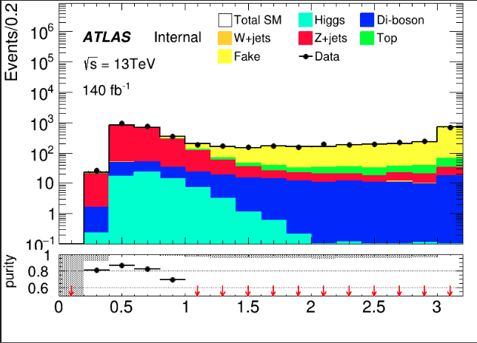
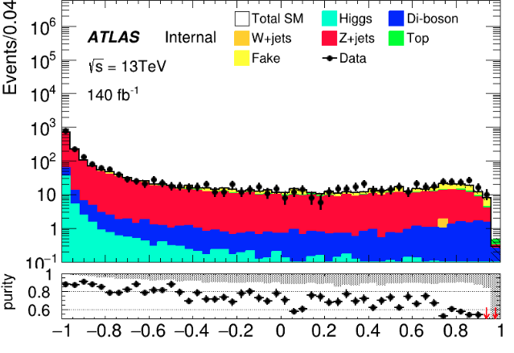
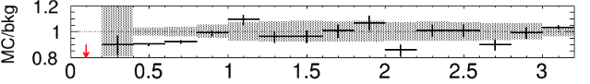
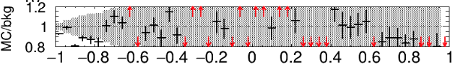
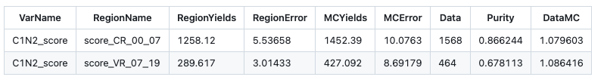
HH channel: Z bkg estimation(run2)
HH pre-selection(drop Mtt reco cut) dRtt <= 1.0 CR: C1N2 score < -0.3 VR: -0.3 < C1N2 score < 0.9
dRtt
C1N2 score

Slide 12
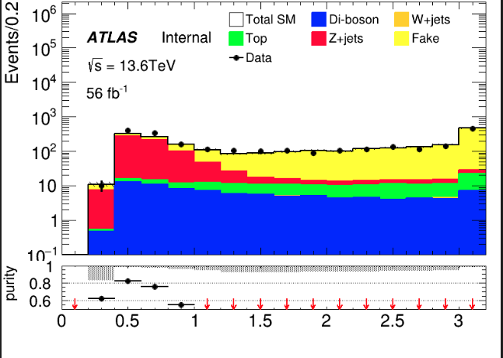
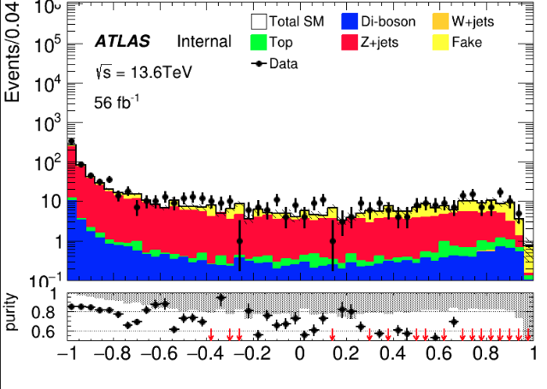
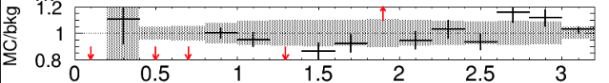
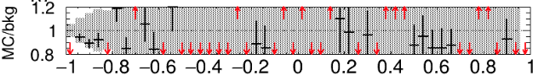
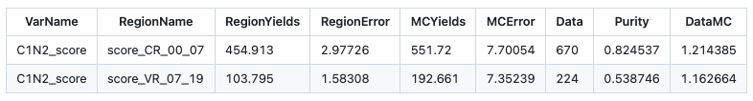
HH channel: Z bkg estimation(run3)
HH pre-selection(drop Mtt reco cut) dRtt <= 1.0 CR: C1N2 score < -0.3 VR: -0.3 < C1N2 score < 0.9
dRtt
C1N2 score

Slide 13
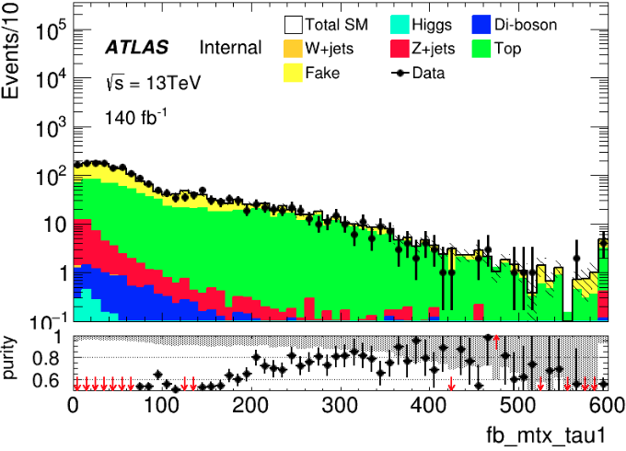
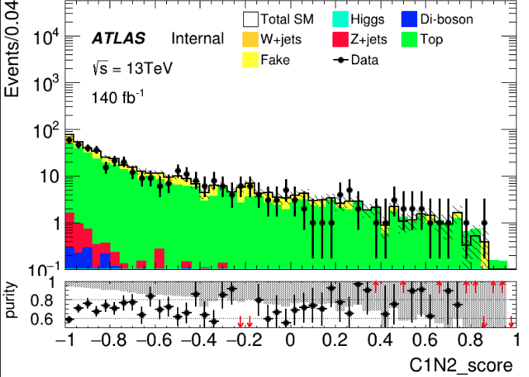
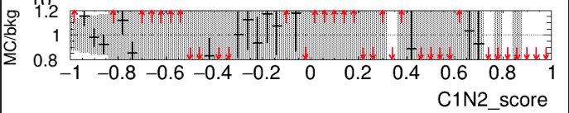
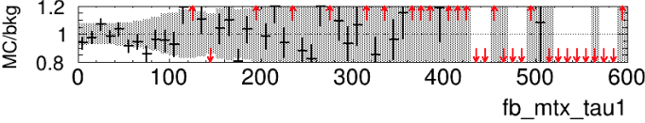
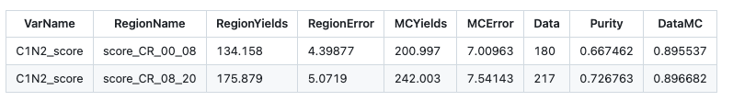
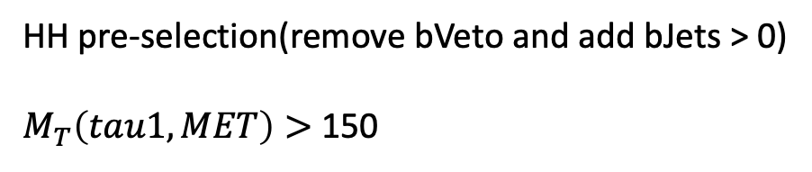
HH channel: Top bkg estimation(run2)
HH pre-selection(remove bVeto and add bJets > 0)
$M_{T}\left(tau1, MET\right)>$150
Orthogonal with SR
CR: C1N2 score < -0.8
VR: -0.8 < C1N2 score < 1.0
Wrong label, should be 00_02
Notes:
Top_CR: 123.241, Error: 4.22913
Top_VR: 103.166, Error: 3.89985
, MC_CR: 168.225, Error: 6.00345
, MC_VR: 131.66, Error: 5.39455
, purity_CR: 0.732596
, purity_VR: 0.783579
Data_CR:137
Data_VR:120, SF:0.817986

Slide 14
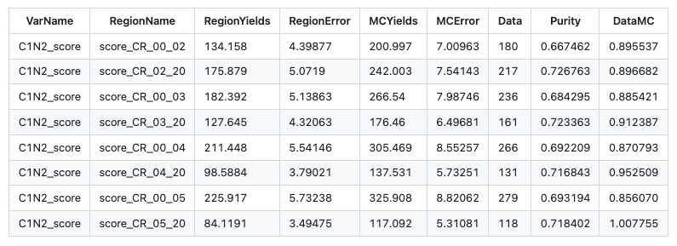
HH channel: Top bkg estimation(run2)
-0.8
-0.7
-0.6
-0.5

Slide 15
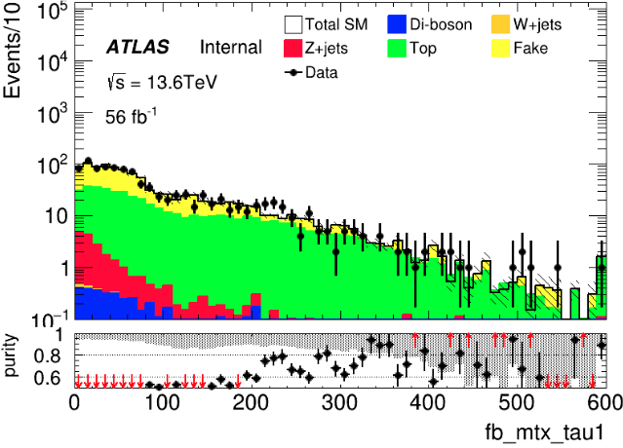
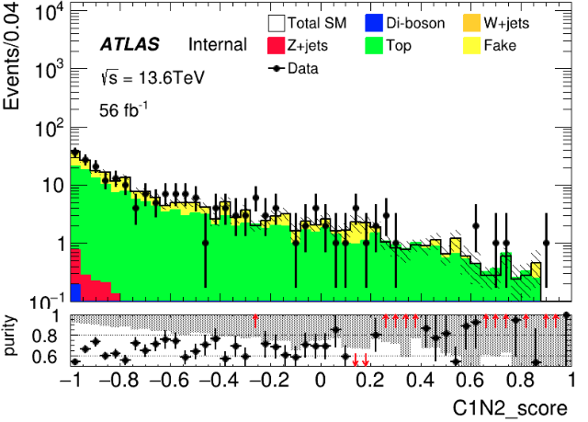
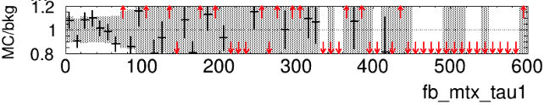
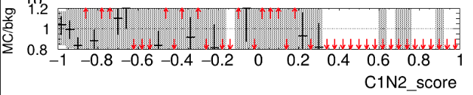
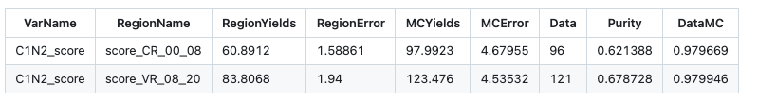
HH channel: Top bkg estimation(run3)
HH pre-selection(remove bVeto and add bJets > 0)
$M_{T}\left(tau1, MET\right)>$150
Orthogonal with SR
CR: C1N2 score < -0.8
VR: -0.8 < C1N2 score < 1.0
Notes:
Top_CR: 123.241, Error: 4.22913
Top_VR: 103.166, Error: 3.89985
, MC_CR: 168.225, Error: 6.00345
, MC_VR: 131.66, Error: 5.39455
, purity_CR: 0.732596
, purity_VR: 0.783579
Data_CR:137
Data_VR:120, SF:0.817986

Slide 16
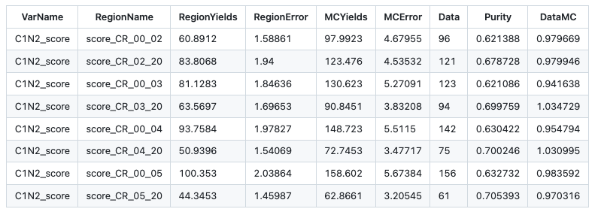
HH channel: Top bkg estimation(run3)

Slide 17
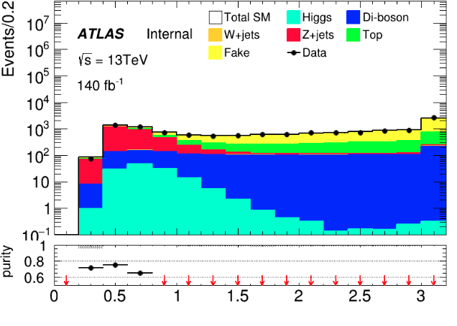
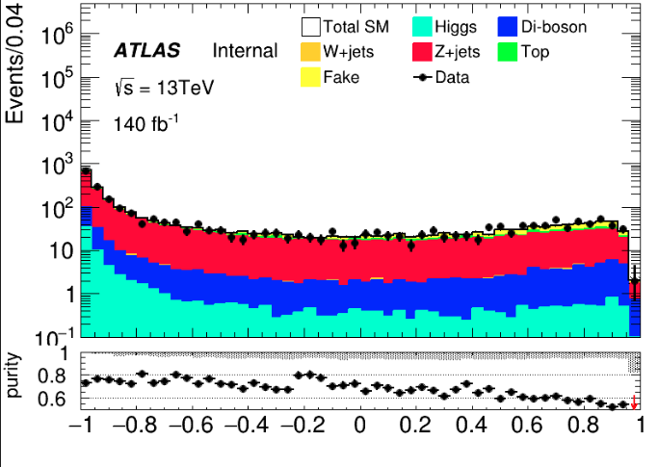
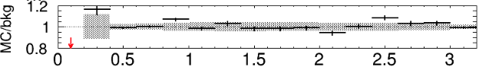
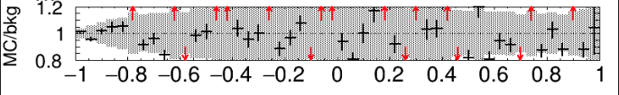
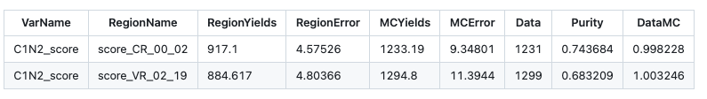
LH channel: Z bkg estimation(run2)
HH pre-selection(drop Mtt reco cut) dRtt <= 0.8
CR: C1N2 score < -0.8 VR: -0.8 < C1N2 score < 0.9
dRtt
C1N2 score

Slide 18
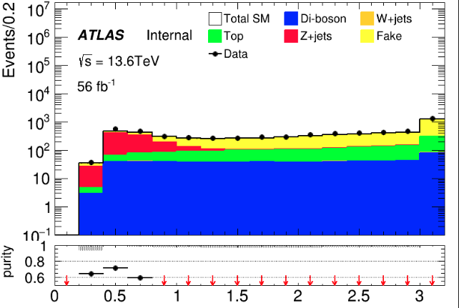
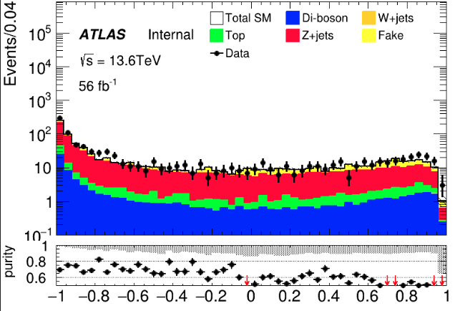
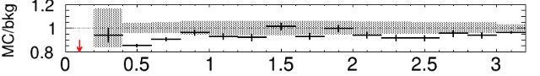
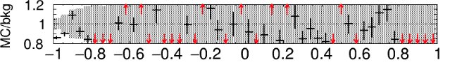

LH channel: Z bkg estimation(run3)
HH pre-selection(drop Mtt reco cut) dRtt <= 0.8
CR: C1N2 score < -0.8 VR: -0.8 < C1N2 score < 0.9
dRtt
C1N2 score

Slide 19






LH channel: Top bkg estimation(run2)
HH pre-selection(remove bVeto and add bJets > 0)
$M_{T}\left(tau2, MET\right)>$110
Orthogonal with SR
CR: C1N2 score < -0.8
VR: -0.8 < C1N2 score < 1.0
Notes:
Top_CR: 123.241, Error: 4.22913
Top_VR: 103.166, Error: 3.89985
, MC_CR: 168.225, Error: 6.00345
, MC_VR: 131.66, Error: 5.39455
, purity_CR: 0.732596
, purity_VR: 0.783579
Data_CR:137
Data_VR:120, SF:0.817986

Slide 20





LH channel: Top bkg estimation(run3)
HH pre-selection(remove bVeto and add bJets > 0)
$M_{T}\left(tau2, MET\right)>$110
Orthogonal with SR
CR: C1N2 score < -0.8
VR: -0.8 < C1N2 score < 1.0
Notes:
Top_CR: 123.241, Error: 4.22913
Top_VR: 103.166, Error: 3.89985
, MC_CR: 168.225, Error: 6.00345
, MC_VR: 131.66, Error: 5.39455
, purity_CR: 0.732596
, purity_VR: 0.783579
Data_CR:137
Data_VR:120, SF:0.817986

Slide 21







Distribution Check
LH Channel
HH TCR run2
HH TCR run3
Change Mtt_reco to [10,130]
run2
run3
LH channel
$$M_{inv}\left(tau2, MET\right)$$
run2
run3

Slide 22








Cross-Check FF
$0<|η|<1$
$1<|η|<1.37$
$1.52<|η|<2.5$
My result
Wenyi’s result
Same value for first two bins and different in last bin for different rebin strategy I check FF with same rebin method in case, it turns out we are the same

Slide 23
Fake Factor for Run2 and Run3
$0<|η|<1$
$1<|η|<1.37$
$1.52<|η|<2.5$
Selection:
nBaseTau == 1
nBaseLep >= 1, SigLep >= 1 MET trigger, MET >= 200
Same-Signal(Orthogonal with SR) bVeto ID: nMediumTau == 1 antiID: nMediumTau < 1
A small bump show in the last bin

Slide 24










MC modeling in Pre-Selection(HH)
run2
run3

Slide 25








MC modeling in Pre-Selection(HH)
run2
run3

Slide 26






MC modeling in Pre-Selection(HH)
run2
run3

Slide 27










MC modeling in Pre-Selection(LH)
run2
run3

Slide 28








MC modeling in Pre-Selection(LH)
run2
run3

Slide 29






MC modeling in Pre-Selection(LH)
run2
run3

Slide 30
C1N2 SR(HH and LH)
Input sample:
bkg: run2 bkg sample passed pre-selection(HH/LH) sig: 100_70, 120_90, 140_90(only run2)
Hyperparameters: HH: Ntrees = 300, MaxDepth = 6, MinNodeSize = 1%, Learning rate = 0.05
LH: Ntrees = 200, MaxDepth = 6, MinNodeSize = 1%, Learning rate = 0.05
Weight choose: abs(physics weight)
Split strategy: Separate entries by using mod 5, for Fake bkg, if separate follow sequence, all weighted entry will split into first fold

Slide 31




BDT distribution for LH and HH
HH
LH
run2
run3

